Slide 1
NFL Draft Assistant
With the right kind of coaching and determination you can accomplish anything

Slide 2
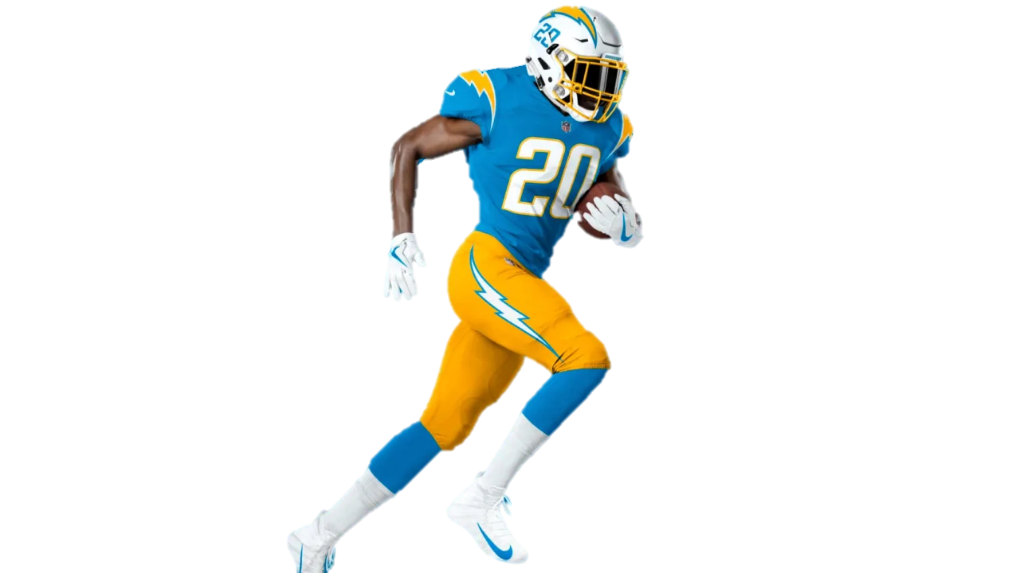
MEMBER
Suphanat Thaiprasit 6310422034
Anuwat Malinee 6310422036
Kavin Singhakhet 6310422040

Slide 3
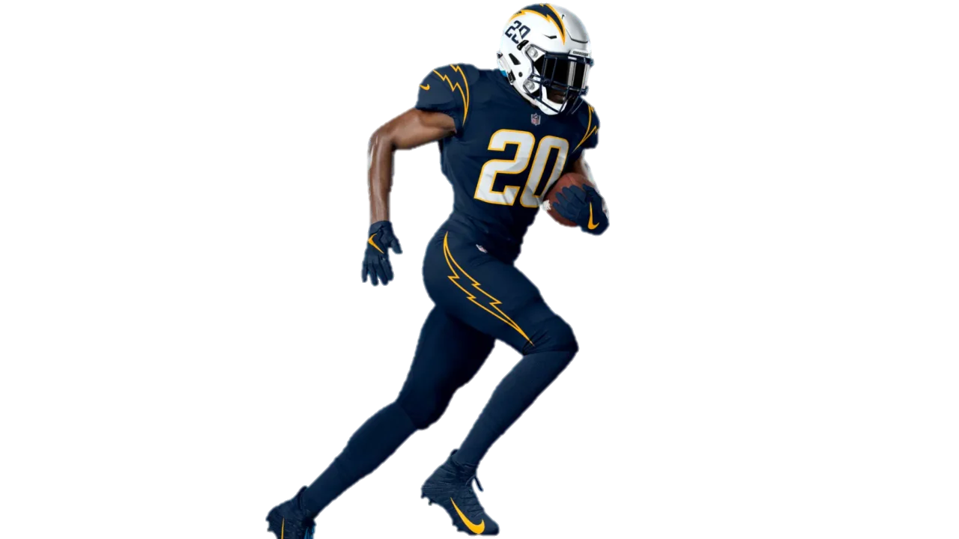
Agenda
01
Problem
02
Data Collection
03
Analysis
04
Result

Slide 4

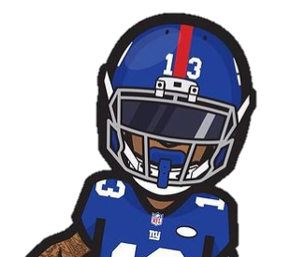
PROBLEM
When you dream to play in the NFL but you are not convinced that you are ready to be the chosen one.
When you have confidence that you will be the chosen one But you still don't know who you should take as a role model.
If you are not selected. How do you know which skills you should improve?

Slide 5
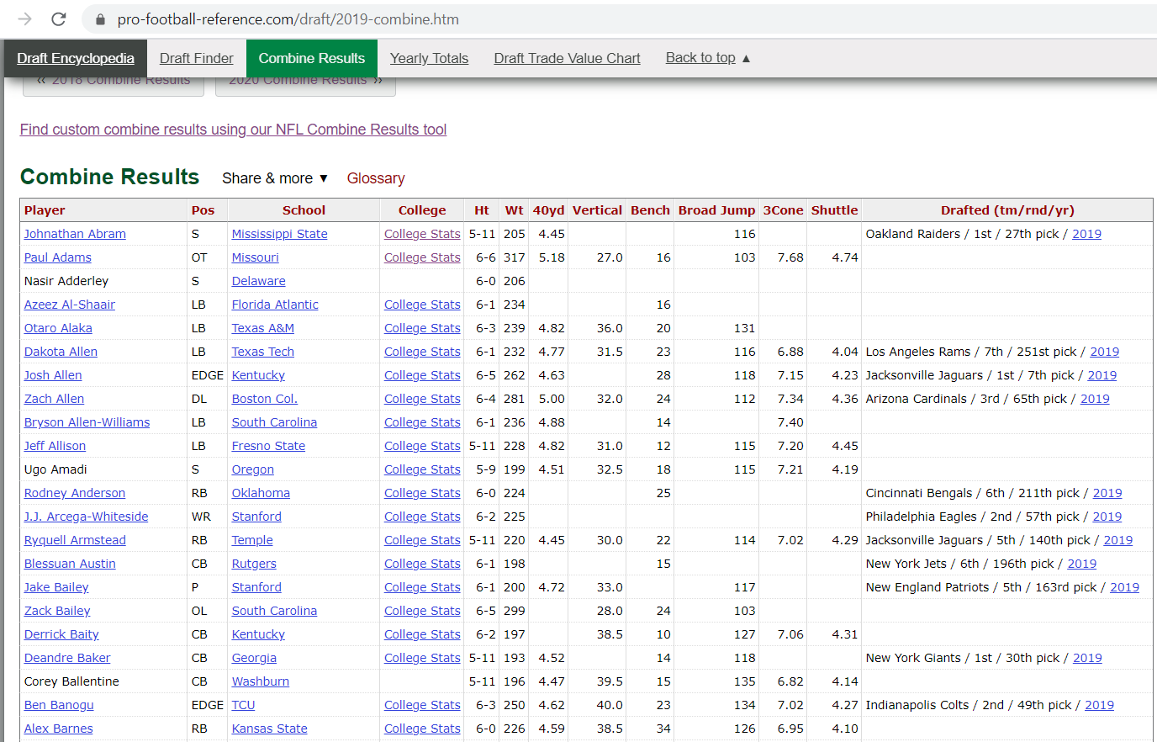
DATA COLLECTION
1. Combine stat table
https://www.pro-football-reference.com/draft/2019-combine.htm

Slide 6
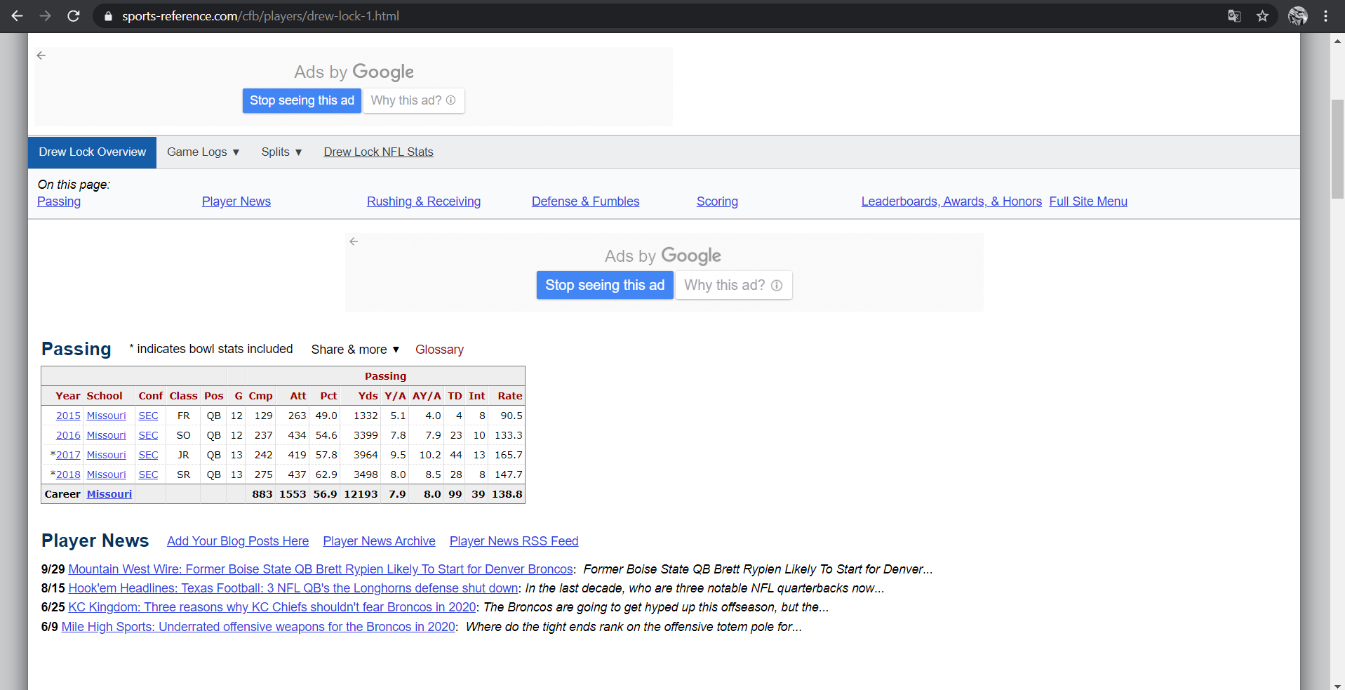
DATA COLLECTION
2. College stat table
https://www.sports-reference.com/cfb/players/drew-lock-1.html

Slide 7
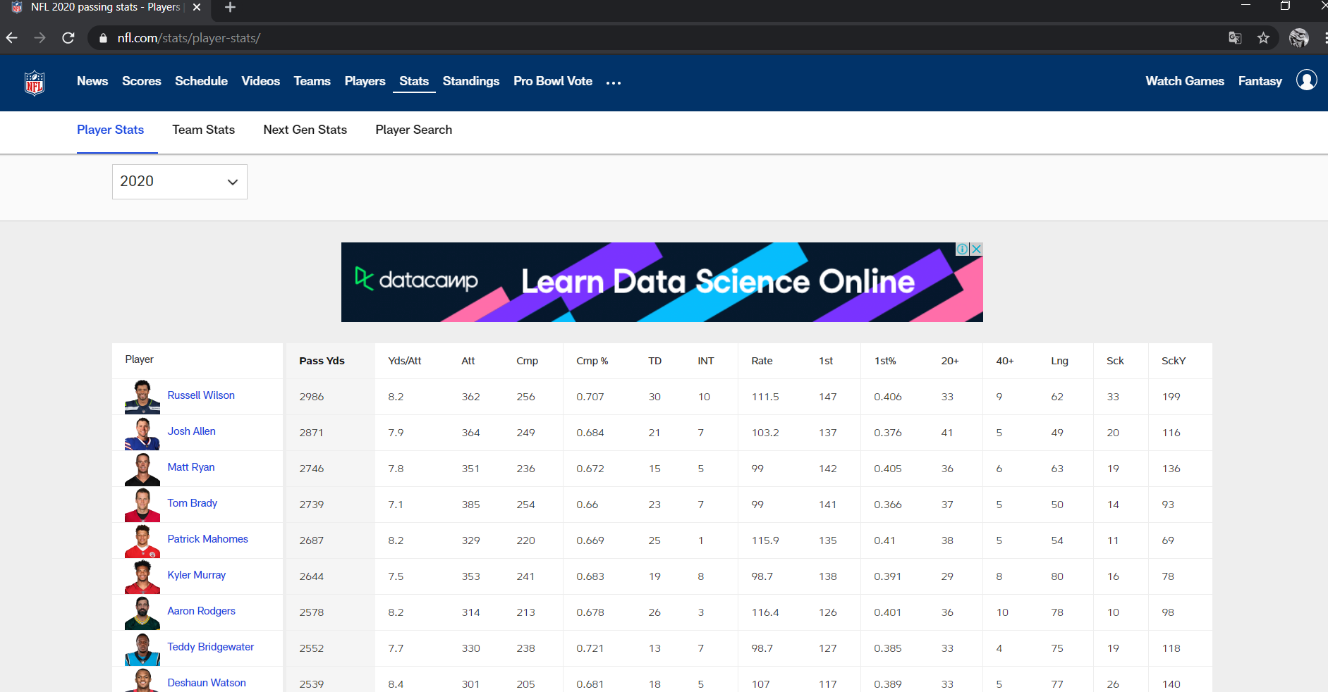
DATA COLLECTION
3. Image data
https://www.nfl.com/

Slide 8
ANALYSIS
1. Classification Model
XGBoost Classifier
Model
Web Scraping Data
Clean Data
Join Table
Prepare data for model

Slide 9




ANALYSIS
2. Similarity Model & Recommendation
DRAFT
Model
INPUT DATA
NOT DRAFT

Slide 10
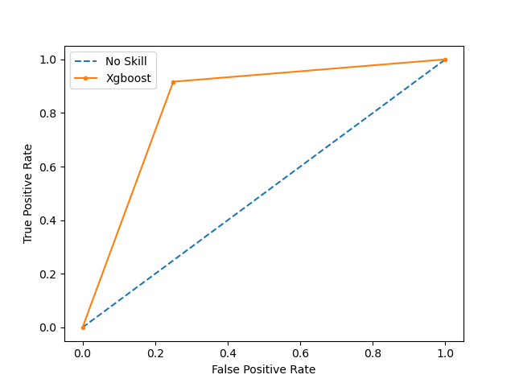
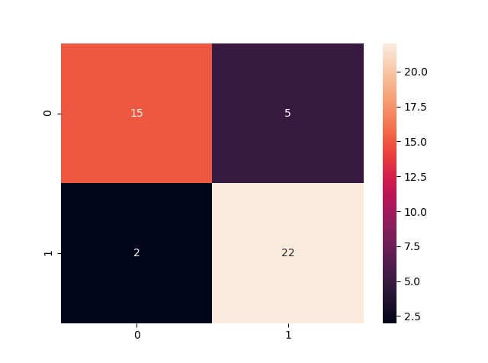
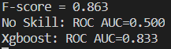
RESULT
1. Classification Model

Slide 11
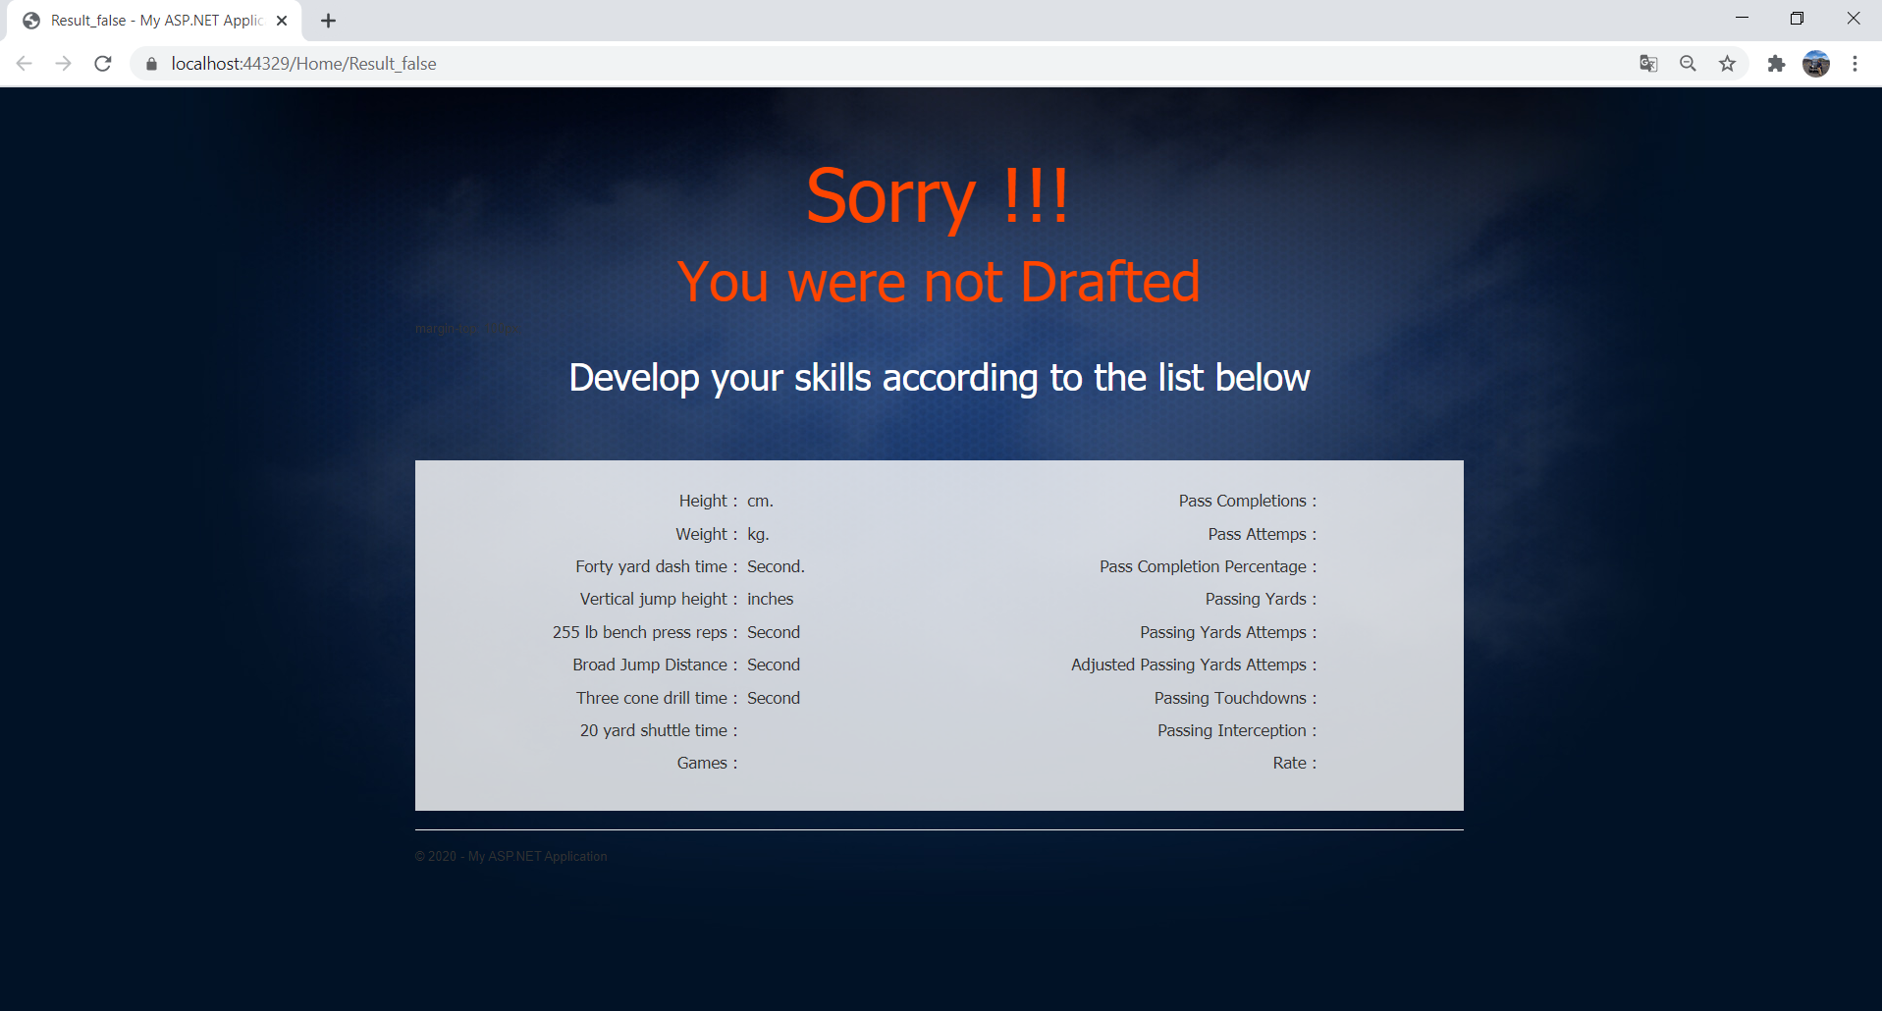
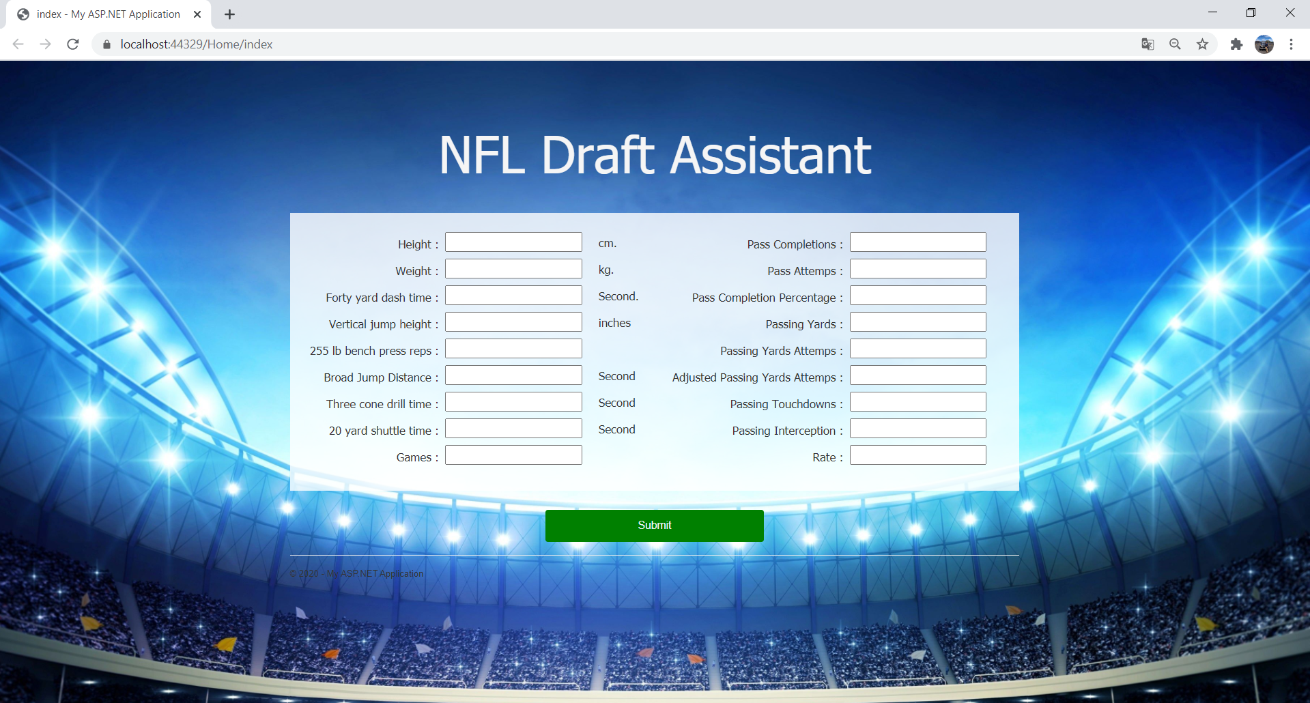
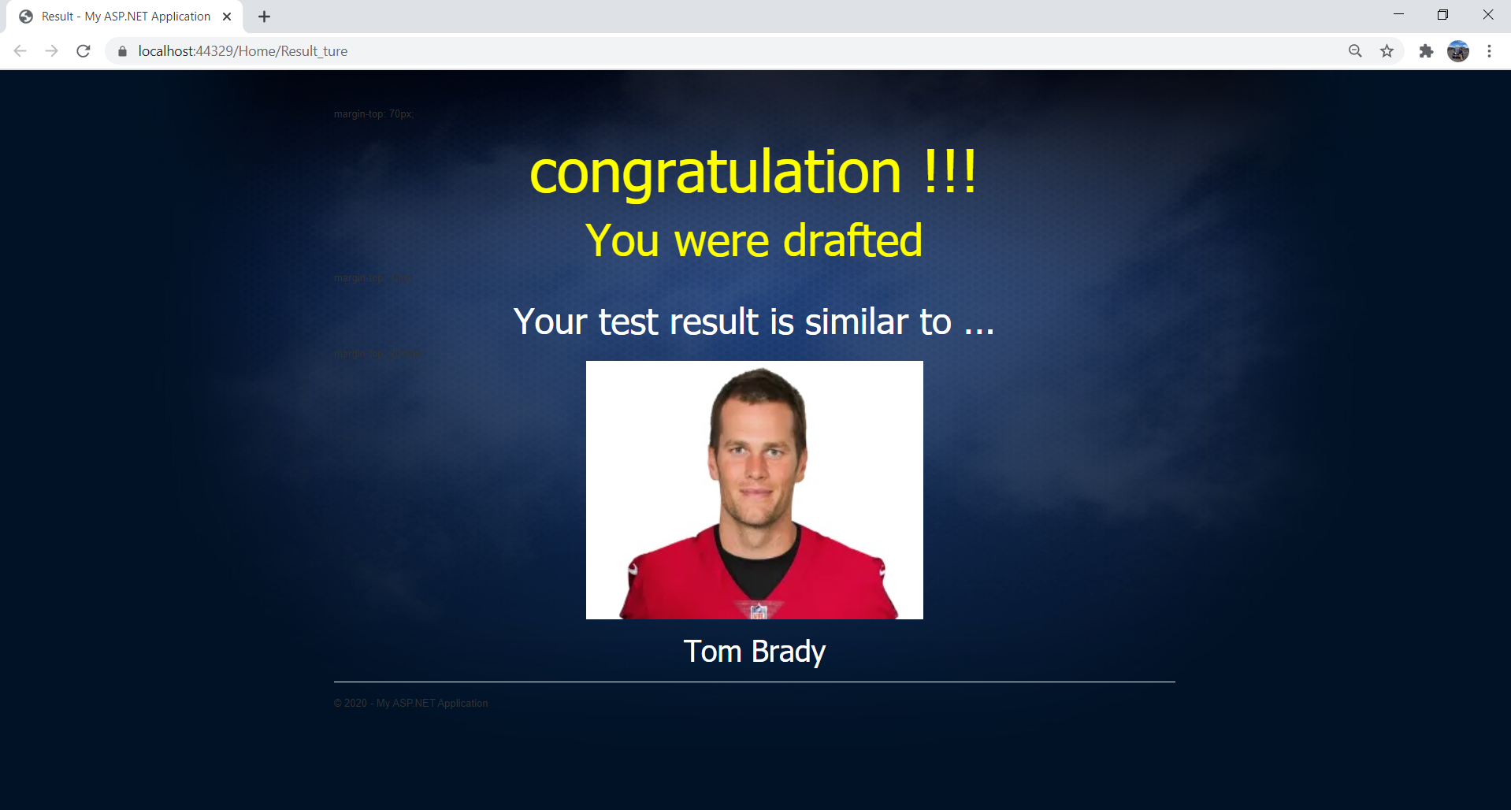
RESULT
2. Similarity Model & Recommendation
RESULT
USER INPUT DATA

Slide 12
APPENDIX

Slide 13
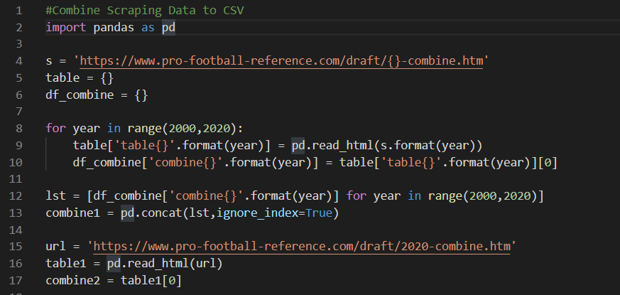
Combine Table Scraping (I)

Slide 14
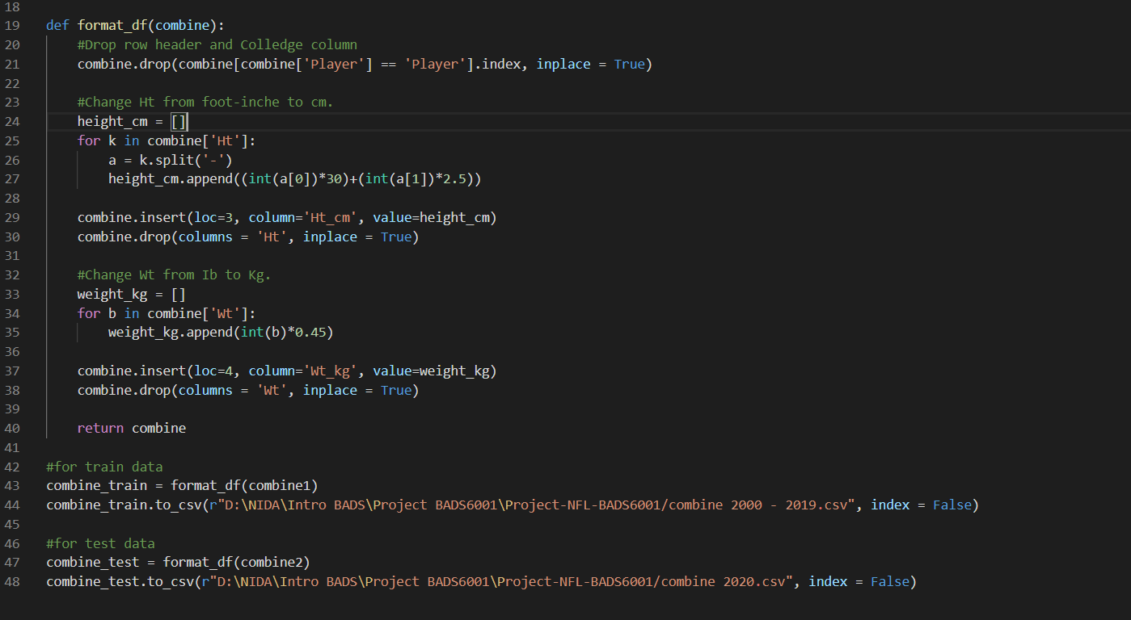
Combine Table Scraping (II)

Slide 15
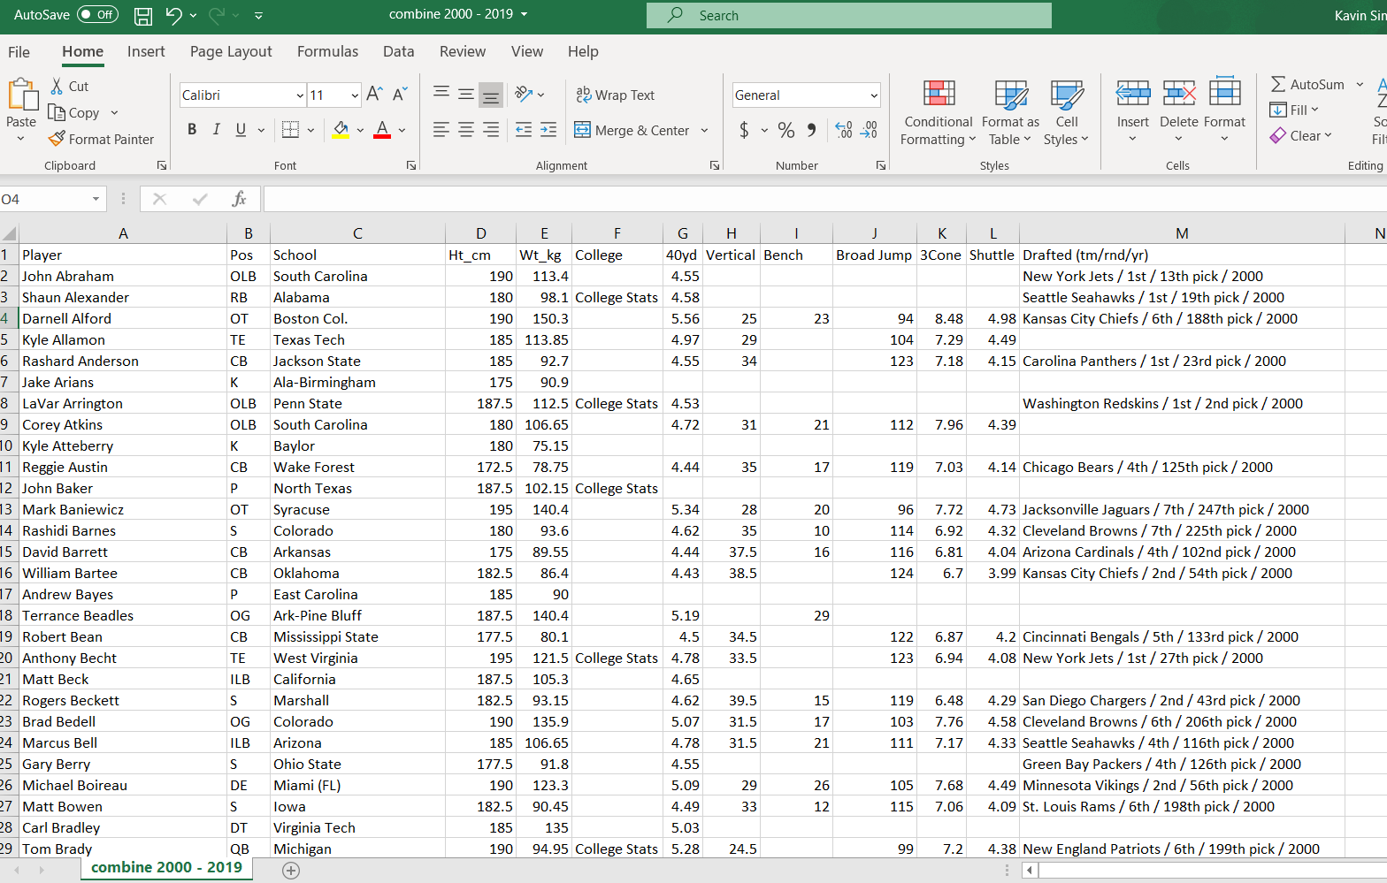
Combine Table Scraping (DATA)

Slide 16
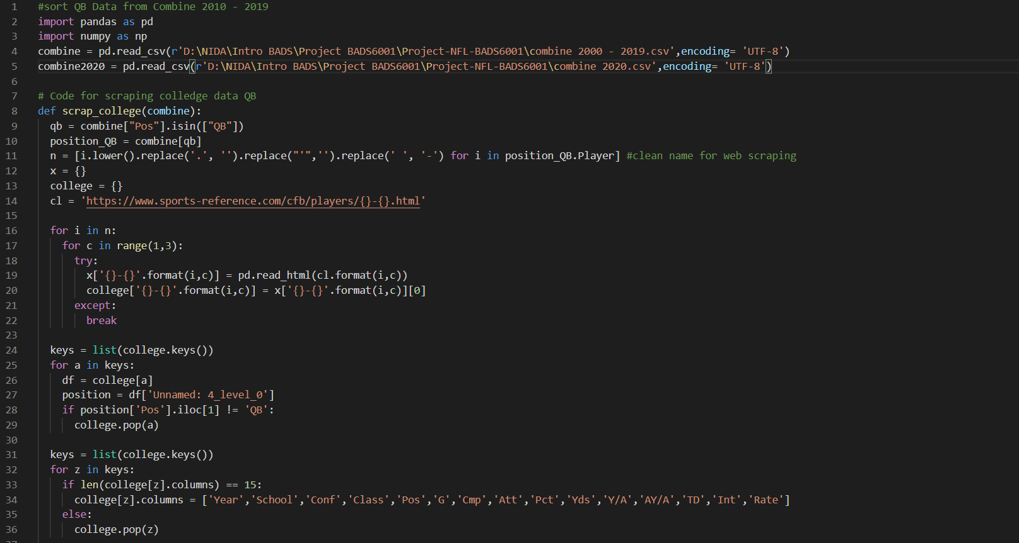
College Table Scraping (I)

Slide 17
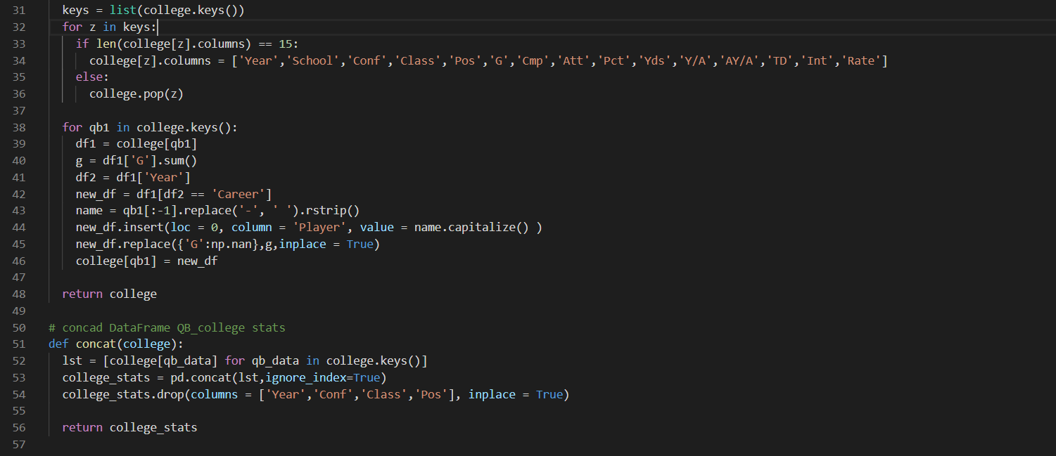
College Table Scraping (II)

Slide 18
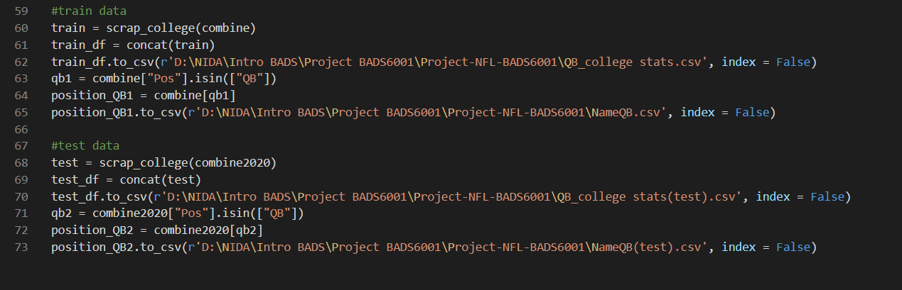
College Table Scraping (III)

Slide 19
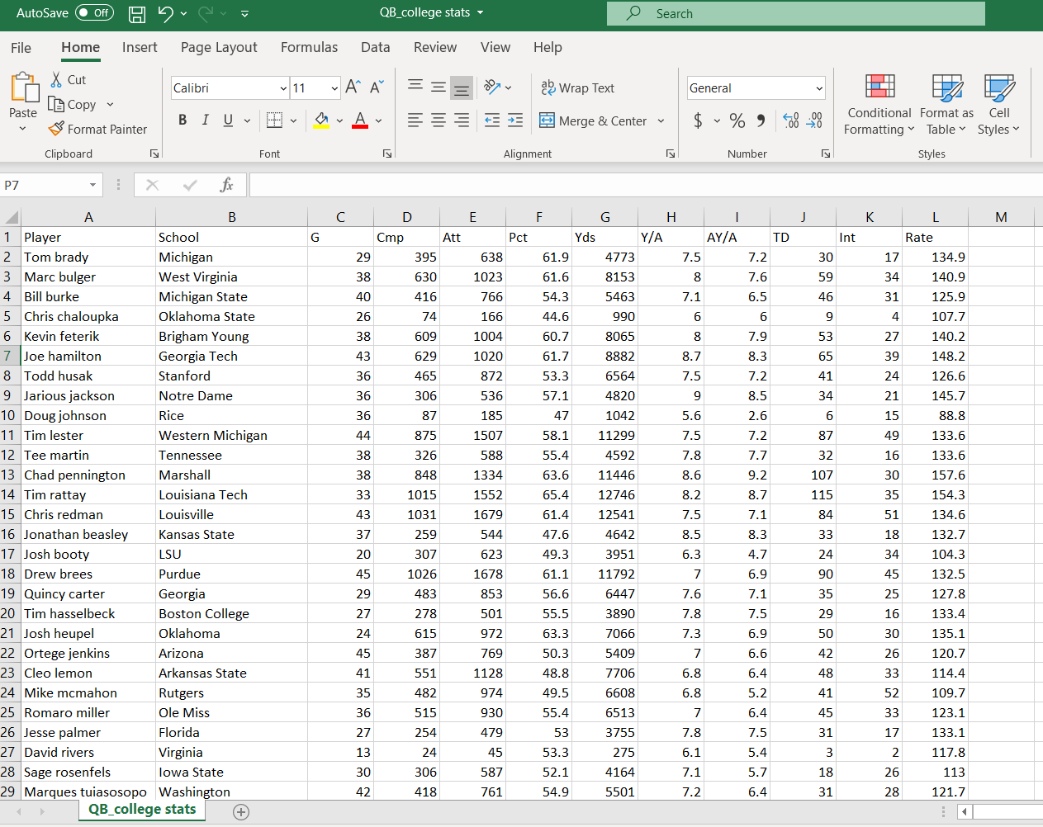
College Table Scraping (DATA)

Slide 20
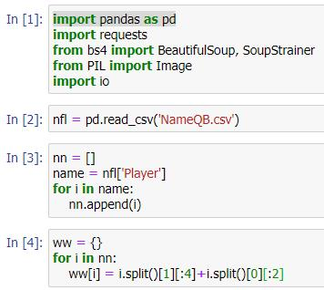
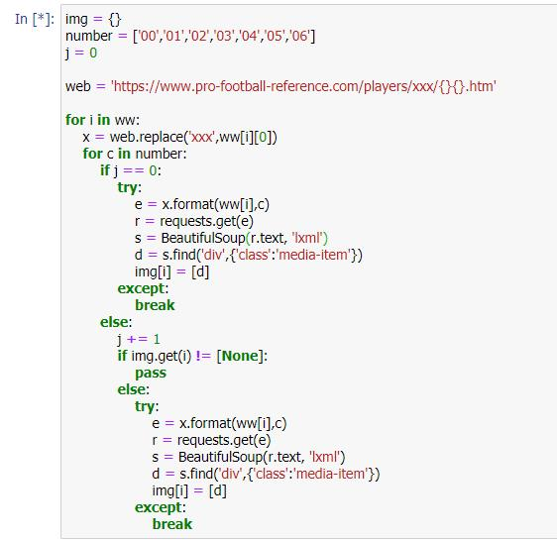
Image Scraping (I)

Slide 21
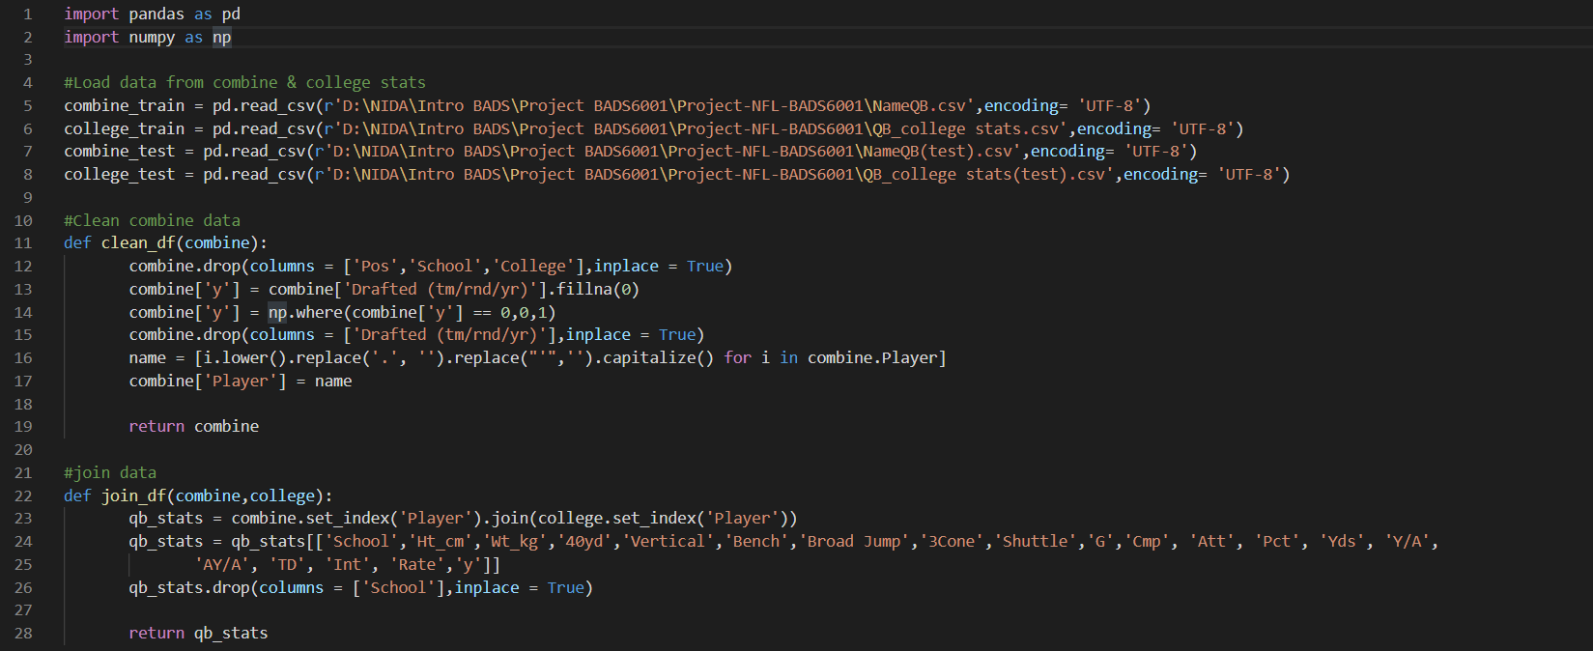
Clean/Join/Prepare Data(I)

Slide 22
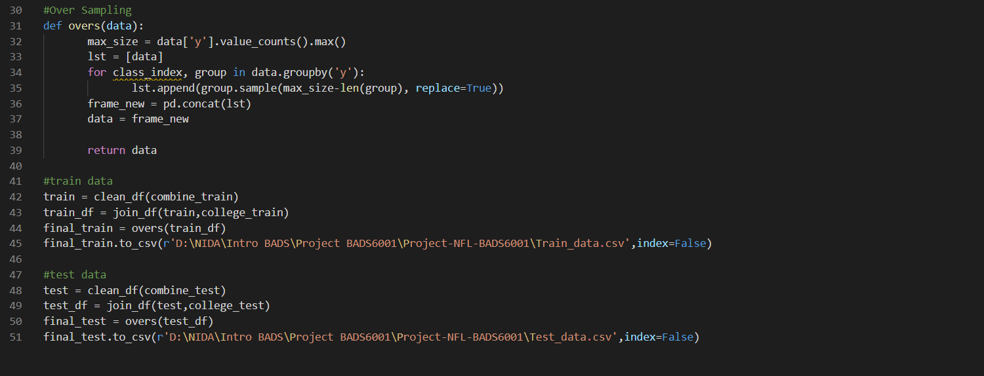
Clean/Join/Prepare Data(II)

Slide 23
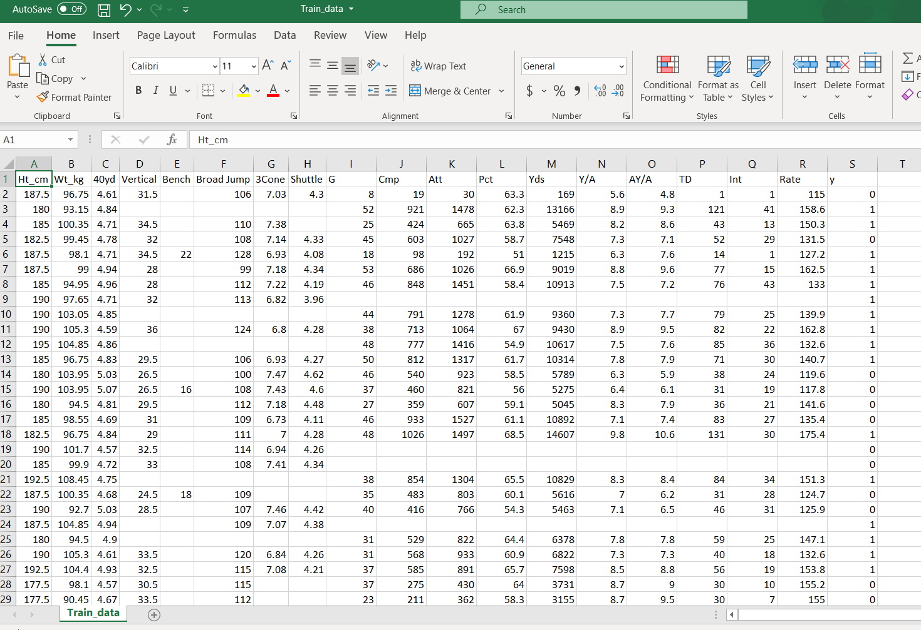
Clean/Join/Prepare Data(I)

Slide 24
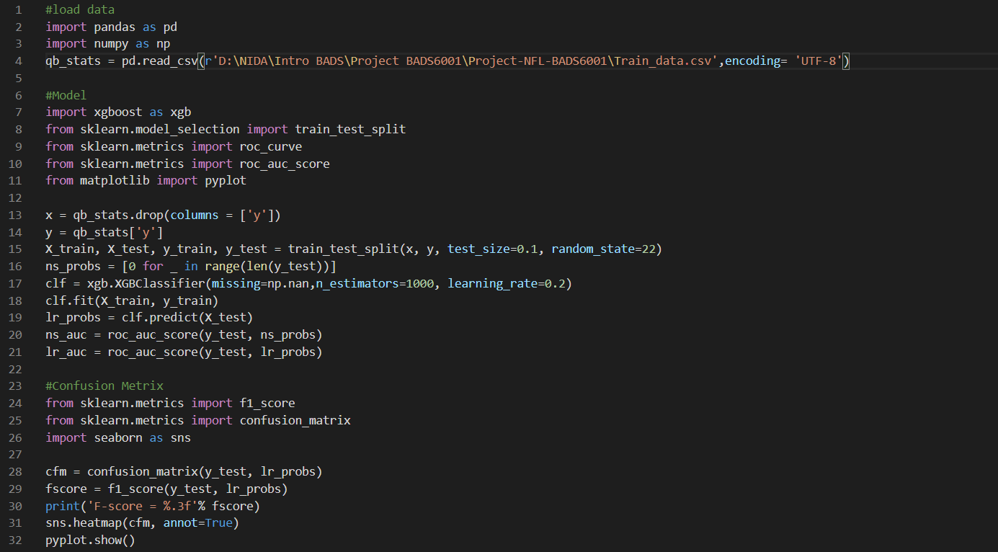
Train Classification Model (I)

Slide 25
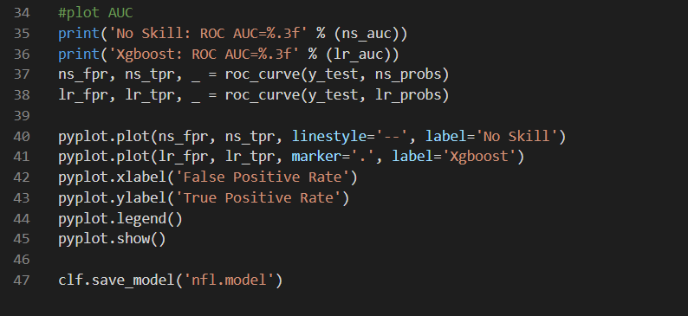
Train Classification Model (II)

Slide 26
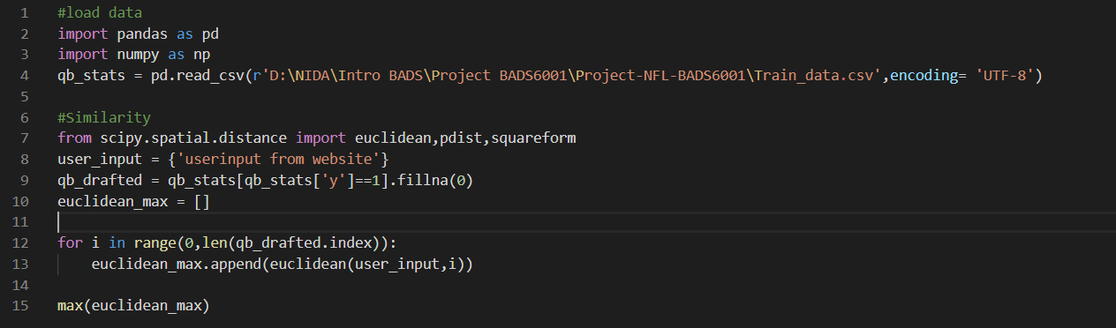
Similarity Model

Slide 27
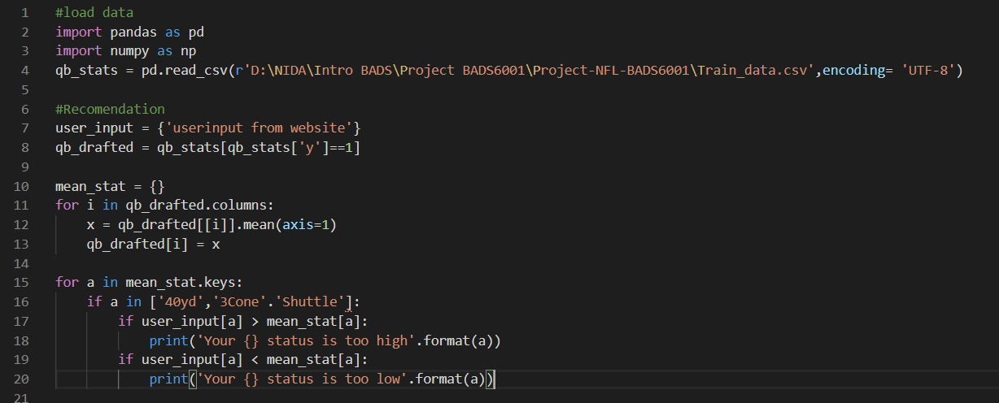
Recommendation Model

Slide 28
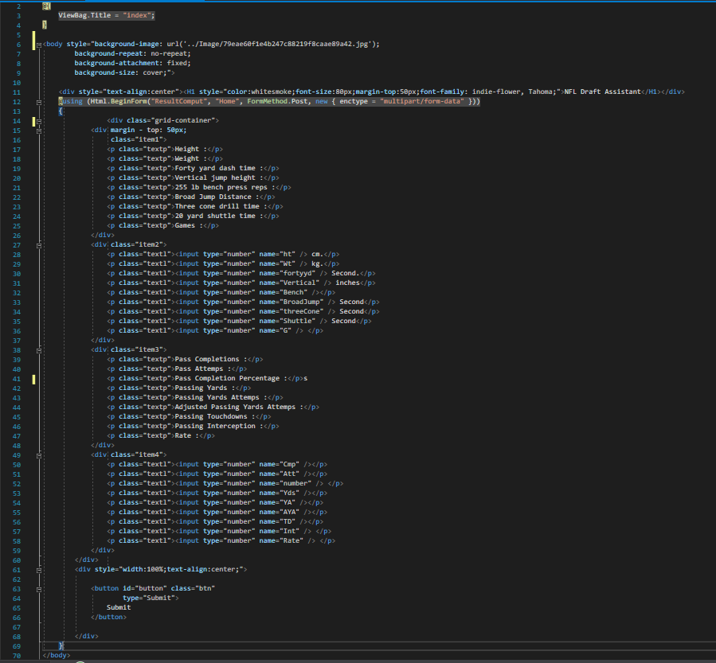
HTML for USER

